Slide 1
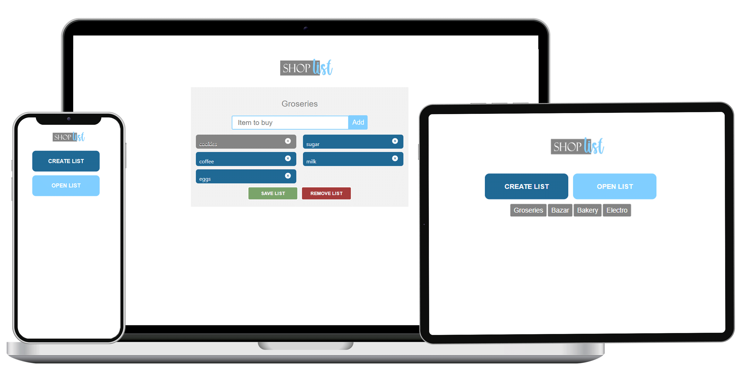
Shopping list application
DLBCSPJWD01
Project Java and Web Development
Name: Romina Alejandra Robles
Studies: Bachelor in Computer Science
Matriculation: 92126700
E-mail: romina-alejandra.robles@iu-study.org
Date: 08.12.2023
DEVELOPMENT
Link to the GIT Repository:
https://github.com/RomiRobles1983/shopping_list_app
Link to the Video:
https://drive.google.com/file/d/1IyNlkEZYKdAS_VdcyFxzqRfoiV-WU7Pp/view?usp=drive_link
The video is also embedded in the last page of the presentation.
Figure 1.

Slide 2

01
Purpose of the web app
Functionalities
A shopping list application that allows users to both create a new list and open a created list, while managing list items during the shopping process.
Create a list with a name.
Add items to the list.
Set items as purchased.
Remove items from the list.
Save the list into the database.
Remove the list (clear list).
Open the saved lists.
Open a list by the name.
Set as purchased items in opened list.
Remove items in opened list.
Update de opened list.
Remove the opened list (deletion from the data base.
Persons seeking to streamline the shopping process by utilizing tools that enable the creation and management of lists.
USER

Slide 3



02
Architecture & Technologies
React Hooks
Frontend
Uses React useState for managing local state within components.
Uses useEffect for handling side effects like API Request.
Nested components
ItemList: Manages the state of the list, renders the list name, items, and handles user interactions.
ListName: Displays and allows editing the list name.
ItemForm: for adding new items to the list.
Item: Represents an individual item in the list (Mapped to obtain the list)
BottomButton: (with conditionals) for saving and removing the list.
TopButton (with conditionals) for open or creating a list.
API Requests:
OpenListRequest: Fetches all list available in the data base.
SaveListRequest: Handles saving or updating a list.
RemoveListRequest: Handles removing a list.
OpenListByNameRequest: Fetches a list by name.
Uses useEffect for handling side effects like API Request.
Media Queries
To achieve responsiveness. For example, on small screens, the home buttons are piled on top of each other, and the list items are in a single column.

Slide 4




03
Architecture
Architecture & Technologies
React Router:
Backend
To manage the different pages of the application
<Route path="/" exact component={Home} />
<Route path="/create-list" component={CreateList} />
<Route path="/open-list/:listName" component={OpenList} />
API Endpoints
/lists: Get all saved lists.
/lists/:name: Open a specific list by name.
/lists: Create or update a list.
/lists/:name: Delete a list by name.
Error Handling in Endpoints:
Error handling returning appropriate HTTP responses and detailed error messages.
Middleware and Configurations:
express.json() for handling JSON data
cors() to allow requests from different domains
MongoDB configuration using Mongoose and the database connection with mongoose.connect()
Environment Variables (env.js)
To handle port and MongoDB URI.
Data Model (Mongoose Schema)
Global Error Handle (function)
To structure lists and items in the database
prints the error stack trace on the console and responds to the client with an HTTP status 500 and a generic error message.
DATA BASE

Slide 5


04
Design Diagram
USER
Page1
HOME
Page 2
Page 3
CREATE LIST BUTTON
OPEN LITS BUTTON
OPEN “C” LIST
CREATE LIST
LIST
“A”
LIST
“B”
LIST
“C”
LIST “C”
Name of your list
add
add
Item to add
Item to add
ITEM 1 (list c)
ITEM 2 (list c)
SAVE LIST
REMOVE LIST
DATA BASE
SAVE LIST
REMOVE LIST
5

Slide 6
05
Architecture Diagram
APP
Route
interface
"/open-list/:listName" component={OpenList}
"/create-list" component={CreateList}
<Route path="/" exact component={Home}
CREATE LIST
HOME
ITEMLIST
ITEMLIST
TOP BUTTON
isCreateListButton={true}
TOP BUTTON
isCreateListButton={false}
LISTNAME
const newName = e.target.value;
OPEN LIST by NAME isOpenListClicked/lists.map((list)
ITEMLIST
ITEMFORM
const manageChanges = e => { setInput(e.target.value) }
OPEN LIST isOpenListClicked/lists.map((list)
openLists// fetch(`${API_URL}/lists`);
ITEMLIST
LISTNAME
const newName = e.target.value;
ITEM
Item({ id, text, purchased, setAsPurchased, removeItem })
ITEMFORM
const manageChanges = e => { setInput(e.target.value) }
{itemsState.map((item) => ( <Item
button {list.name}
button {list.name}
ITEM
Item({ id, text, purchased, setAsPurchased, removeItem })
<BottomButton isSaveListButton={true}
<BottomButton isSaveListButton={false}
{itemsState.map((item) => ( <Item
clearListInfo()
DATA BASE
Controllers
getLists ()
createOrUpdateList()
openListByName ()
deleteListByName()
.
Endpoints
/lists: Get all saved lists.
/lists: Create or update a list.
/lists/:name: Open a specific list by name.
/lists/:name: Delete a list by name.
<BottomButton isSaveListButton={true}
<BottomButton isSaveListButton={false}
Dblist (mongoose)
const listSchema = new Schema
Save List
6
DATA BASE

Slide 7
06
Test Cases
Opening a list by name
adding items to the list.
removing items from the list.
setting items as purchased.
changing the name of the list
Creating a list
Removing a list
Removing a list
adding items to the list.
removing items from the list.
setting items as purchased.
removing a list that exists in the database.
removing a list that doesn't exist in the database.
APIs Error handling
The list cannot be saved
The list cannot be open
The list cannot be update
The list cannot be update
Saving a list
Opening the lists
Opening the lists
Opening one of the list saved in the database.
Saving a list with no name.
Saving a list with no items.
Saving a list with name and Items.
USER Error handling
List with no name
List with no items
Responsive Design
Tested for different screen sizes with Chrome development tools

Slide 8
07
Differences with the conception phase
No substantial CHANGES were made with respect to the conception phase, but specifications and technologies that were not taken into account had to be DEVELOPED/ADDED in order to achieve the required functionalities:
Use of React Router to manage the different pages of the application.
Merge of the functions createList y updateList into createOrUpdateList to shorten/simplify development.
Added the clearList function that clears the list, to leave the removeList function to the scenario where the list is stored in the database.
Taking into account the Test Cases, functions that had not been taken into account were added to achieve, for example:
Not allowing name changes in the list once it was saved.
Clean the input of the form once the item had been entered into the list.
Prevent "form reloading" with each item added.
Function that gives unique ids to the items in case they are not added when opened from the database.

Slide 9
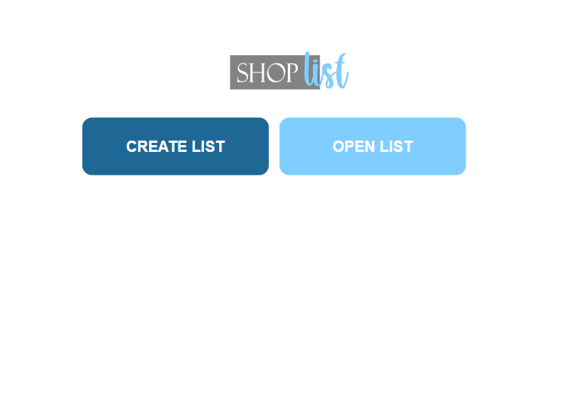
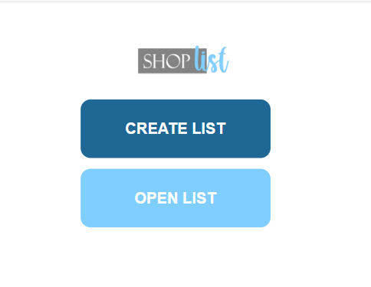
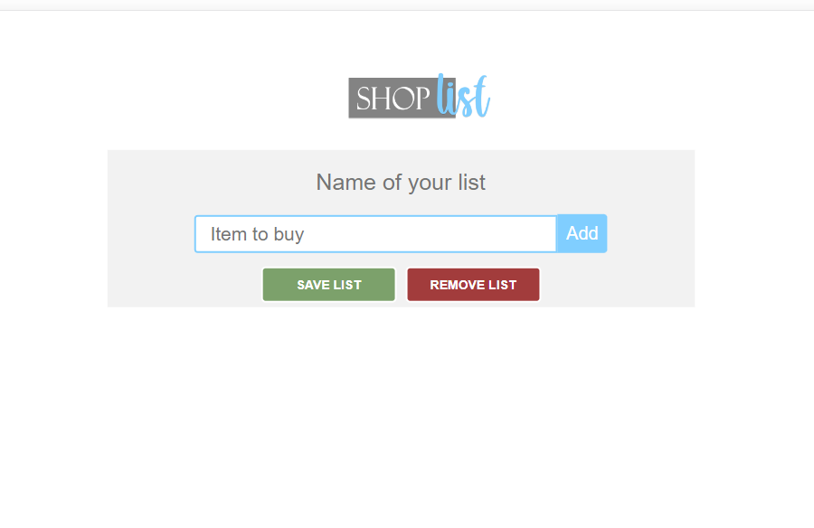
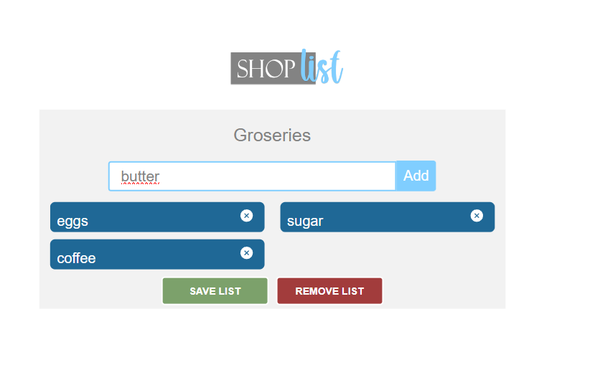
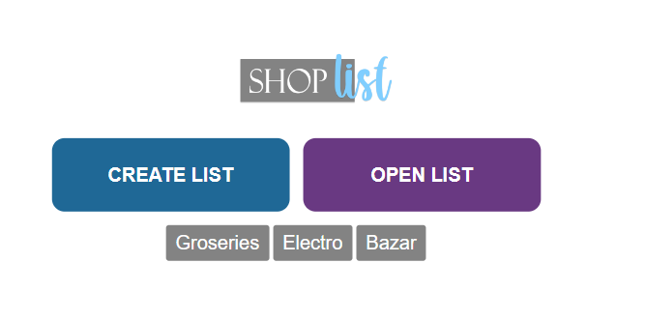
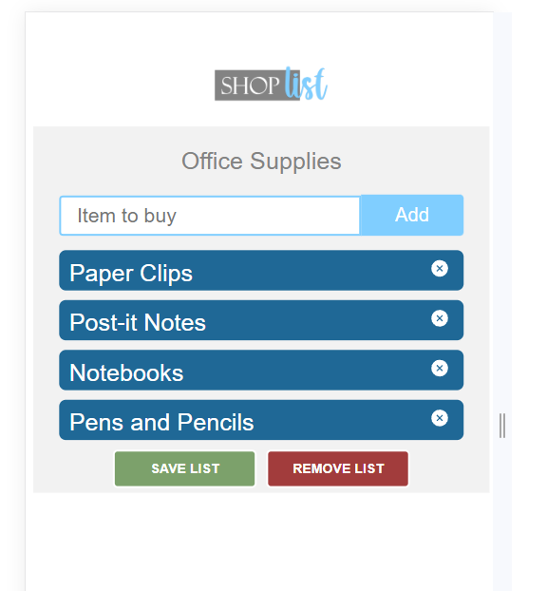
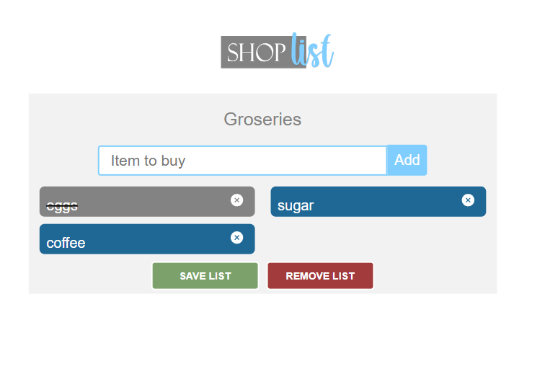
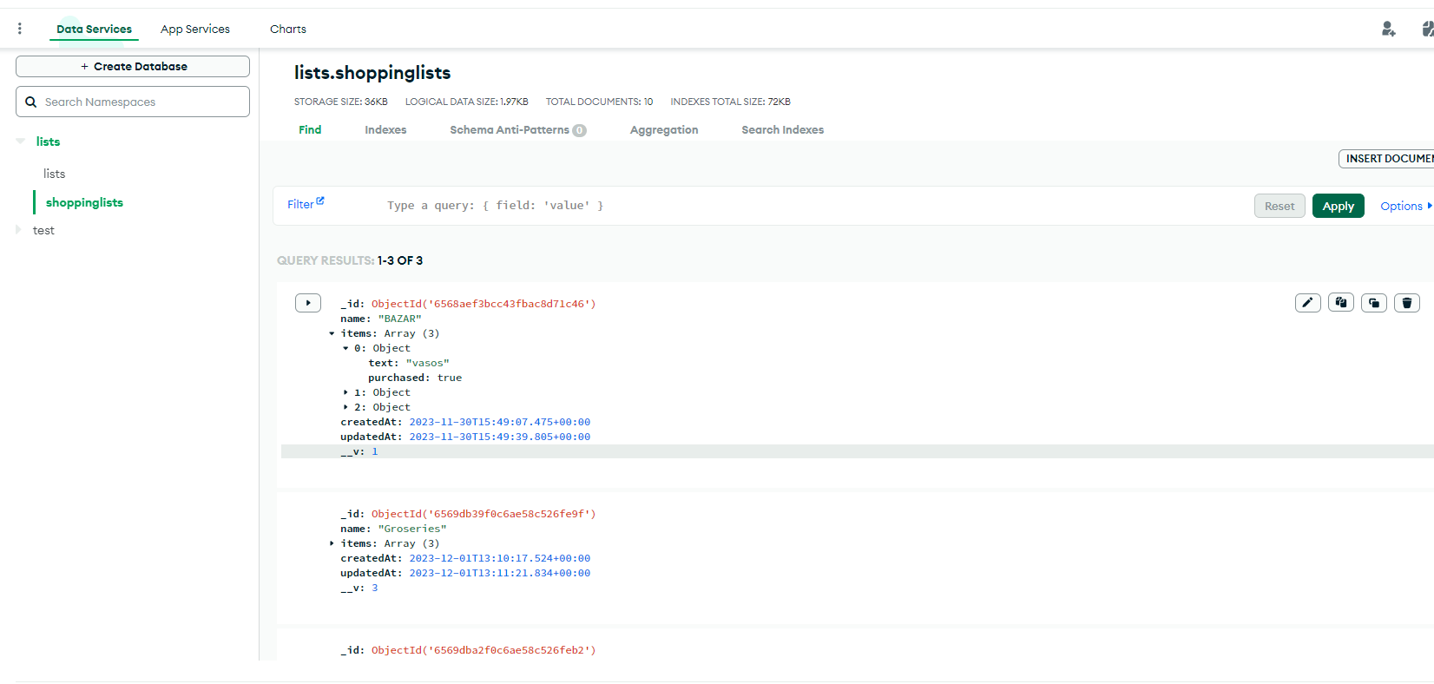
08
Screenshots of the application
Home for smaller screens
After clicking “CREATE LIST”
handling the entry of
items to a list
Home
After clicking “OPEN LIST”
Adding Items in a smaller screen
Opening the list
by name
Database
mongoDB

Slide 10

09
VIDEO

